Slide 1

Asset Rental Agreement & Financial Analytics
Data Science Practicum 1 — Proposal, MSDS692_S40_Data Science Practicum
Prakash Ghatani | Regis University, Denver CO | pghatani@regis.edu
This asset's rental agreement analysis helps understand rental costs, contracts, vendor information, and missing data. The project also uses data analysis and machine learning to predict future monthly rental costs.

Slide 2
Business Problem &
Research Questions
The company has many leased assets in different locations.
These assets are managed under different contracts, vendors, and manufacturers.
It is difficult to find expensive assets without data analysis.
It is also hard to find unusual rental costs and contract risks.
Data analysis can help find ways to reduce costs and improve lease management
Main prediction target: Asset Rental Expenses
Which vendors and manufacturers have the highest rental costs?
Which asset types generate the highest monthly rental amounts?
Are there any unusual rental amounts compared to asset costs?
Which factors best predict asset rental amounts?
How can lease costs be reduced and lease management improved?

Slide 3
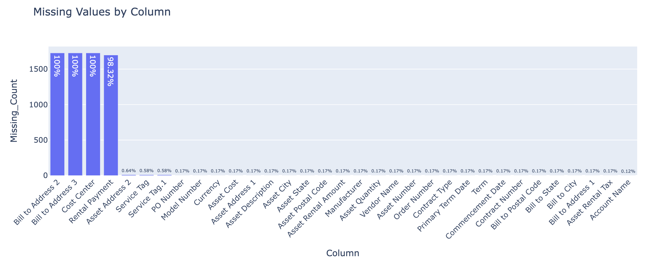
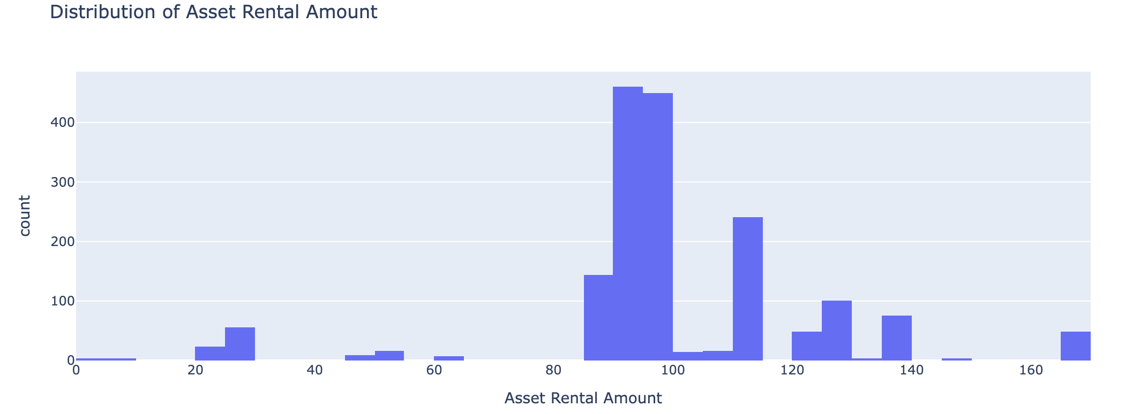
Accessing the Data and Data Analysis
Load the Excel file
Review rows, columns, data types, and missing values
Define the business goal and prediction target
Descriptive statistics
Vendor and manufacturer cost analysis
Rental amount distribution
Asset cost vs rental amount relationship
Missing data visualization
Notes:
Key EDA Findings
3 columns are completely empty (100% missing):
Bill to Address 2
Bill to Address 3
Cost Center
Rental Payment is almost entirely missing (98.3% missing) and may need to be removed from modeling.
Most other columns have very few missing values and can be handled with simple imputation or record review.

Slide 4
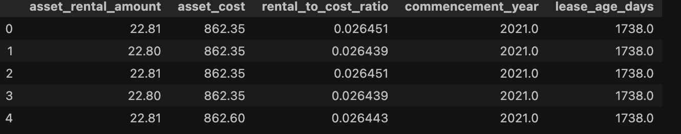
Prepare Data
Clean column names
Handle missing values
Create useful features such as rental-to-cost ratio, lease age, and days until primary term end
Encode categorical variables

Slide 5
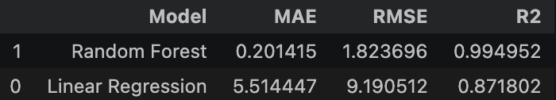
Regression Modeling
1. Linear Regression
2. Random Forest Regressor
Compare model performance using
Mean_absolute_error(MAE),
RMSE(Root Mean Squared Error),
R²(R-squared,Coefficient of Determination)

Slide 6
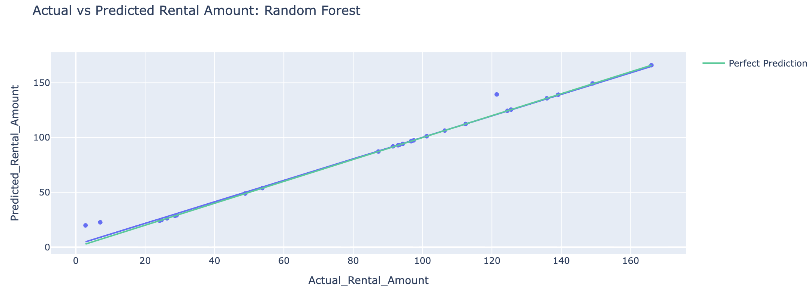
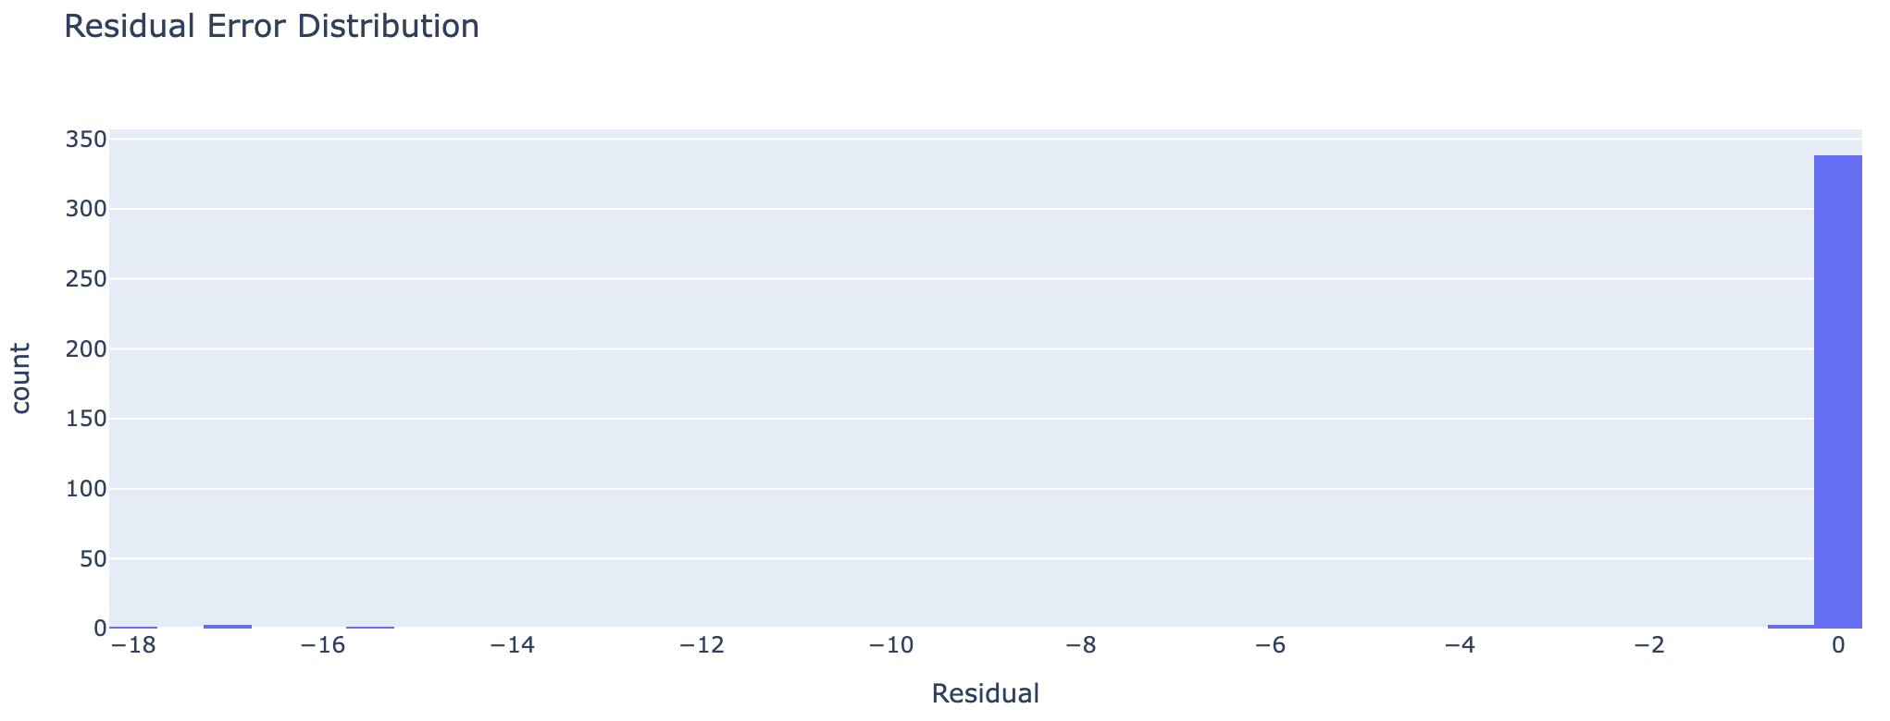
Model Evaluation and Visualization
Actual vs predicted rental amount plot
Feature importance chart
Residual error review

Slide 7
Business Recommendations
1. Monitor high-cost vendors and
2. Review assets with high rental-to-cost ratio
3. Improve missing data quality
4. Use the prediction model as a screening tool
5. Build a renewal dashboard

Slide 8
Conclusion
Analyzed 1,727 lease assets and 29 contracts.
Found the main factors affecting rental costs.
Identified missing data and unusual rental amounts.
Built models to predict monthly rental costs.
Provided recommendations to improve lease cost management.

Slide 9
Thank You

